Slide 1

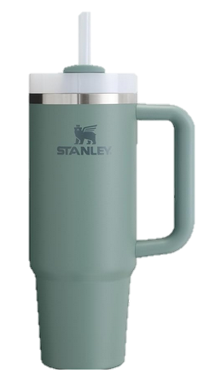
Product Review Summarization
www.stanley.com/cup
Logan Balfantz, Lucie Ellis, Daymine Snow, Shivang Thakor
Unstructured Data Analytics
April 29, 2024
Notes:
SCQA Framework
Situation – COVID-19 made video popular
Complication – Our current provider is facing instability as an organization
Question – Should we continue investing in our partnership with our current provider?
Executive summary
Answer – No, our team of academic technologists recommends that we invest in a partnership with YuJa instead for SE1, SE2, and SE3
Why? - Advantages
SE1 – YuJa has a demonstrated track record of developing innovative academic features.
majority academic market, 100+ developers. We piloted YuJa this semester.
project description
SE2 – Qualitative insights indicate faculty preference for YuJa, meeting our business objectives
business objectives
SE3 – YuJa’s cost is on par with other tools in the space.
cost
How? – Implementation
- project scope and deliverables
- timeline, assumptions, and constraints
- risks and mitigation
- communication plan
Next steps and conclusion

Slide 2



Question &
Data Collection
Data Cleaning &
Analytics Process
Key Findings
& Future Work

Slide 4
Question &
Data Collection
Notes:
1x1 icon
2.6x2.6 circle
.135 Icon
0.35x0.35 circle

Slide 5
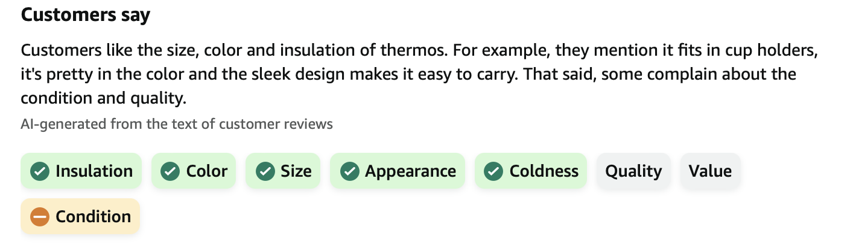
Question
Many customers waste tons of time reading reviews before making a purchase.
How can we make Amazon Comprehend, which summarizes customer reviews, work for other websites?​
April 2024
Unstructured Data Analytics
Notes:
1x1 icon
2.6x2.6 circle
.154 Icon
0.4x0.4 circle

Slide 6
Data Collection
We scraped over 700 reviews Amazon’s product listing for the Stanley Tumbler, resulting in our data frame:
Stanley Cup
review_id
text (review)
rating (1-5)
April 2024
Unstructured Data Analytics
Notes:
1x1 icon
2.6x2.6 circle
.154 Icon
0.4x0.4 circle

Slide 8
Data Cleaning &
Analytics Process

Slide 9
Data Cleaning
Remove non-English reviews​
Tokenize reviews by sentence & add identifier
Convert review text to lowercase
Tokenize sentence-level reviews by word
Remove numbers, ​unnecessary characters
Remove stop words ​
Stem words
Stanley Cup
new_review_id
text (cleaned)
word
rating (1-5)

Slide 10
Sentiment Analysis
We utilized sentence-level​ sentiment analysis to calculate sentiment by review
Jockers-Rinker​ lexicon
Sentence-level accounts for valence shifter​s (i.e., negators, amplifiers, de-amplifiers, and adversative conjunctions​)
Stanley Cup
new_review_id
text (cleaned)
word
rating (1-5)
sentiment
April 2024
Unstructured Data Analytics

Slide 11
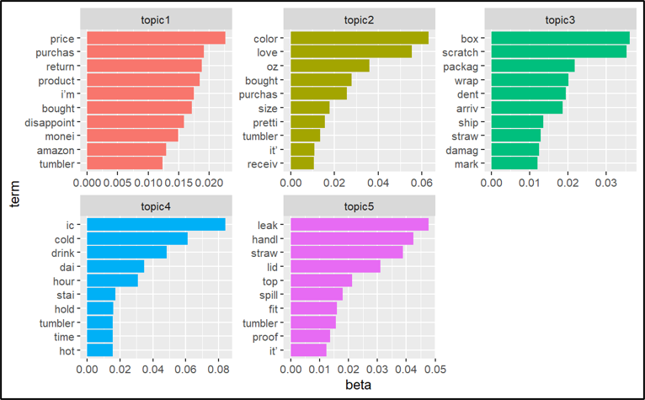
Topic Modeling
LDA Model
k = 5
method = "Gibbs"
alpha = 0.1
delta = 0.1
seed = 123
Here, we determine topics
Topic 1: Value
Topic 2: Color/Size/Appearance
Topic 3: Condition
Topic 4: Insulation/Coldness
Topic 5: Quality
April 2024
Unstructured Data Analytics

Slide 13
Key Findings & Future Work

Slide 14
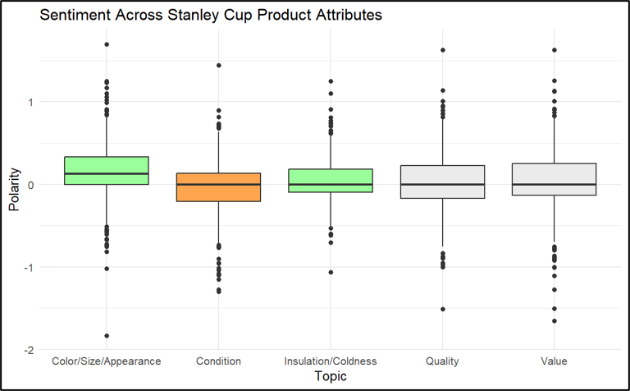
Key Findings
Let’s compare our results
Color/Size/Appearance: Both Positive
Insulation/Coldness: Both Positive
Quality: Both Neutral
Value: Both Neutral
Condition: Both Negative
We find near-perfect alignment with Amazon Comprehend...
April 2024
Unstructured Data Analytics
Notes:
Ensure YuJa is functionally integrated with necessary ND systems
Deliver SSO, LMS, and Video Conferencing integration
Deliver system tests before the start of the fall semester
Minimize the cognitive switching cost for faculty, staff, and students
Deliver content migration for faculty
Deliver change management / communication plan
Deliver support documentation and training
Leverage migration as a time to present pedagogical benefits of video media for teaching and learning
Deliver coordinated outreach to faculty for information on how video and other technologies can impact pedagogy
Out of Scope
Migrating video from the Panopto system that has expired
Migration of non-Panopto video to YuJa (e.g., YouTube videos)

Slide 15
Future Work
Nonetheless, our study is limited…
Bag of words assumption and single-feature review assumption
We find lots of convergence around an average sentiment of 0
Given more time, we would:
Try to replicate our model’s alignment on other Amazon products
Build a model able to identify multiple topics per review
Notes:
- project scope and deliverables
- timeline, assumptions, and constraints
- risks and mitigation
- communication plan

Slide 16

Thank you. Any questions?
www.stanley.com/cup

Slide 17
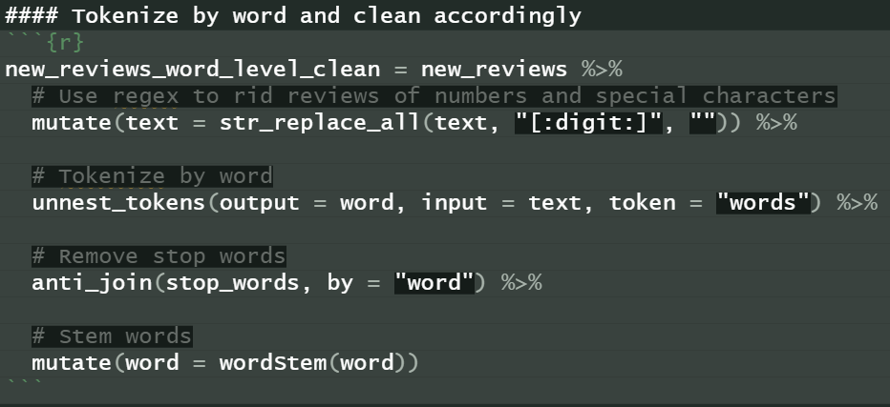
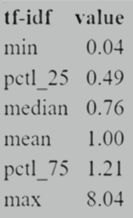
Data Cleaning
April 2024
Unstructured Data Analytics

Slide 18
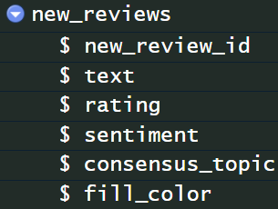
Final Dataset
April 2024
Unstructured Data Analytics

Slide 19
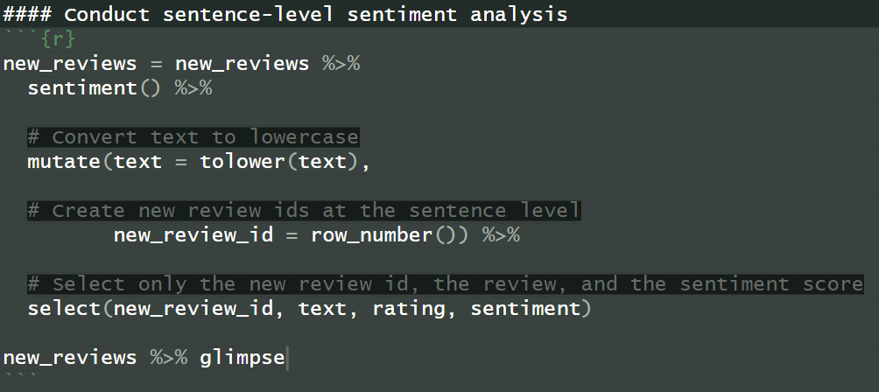
Sentiment Analysis
April 2024
Unstructured Data Analytics

Slide 20
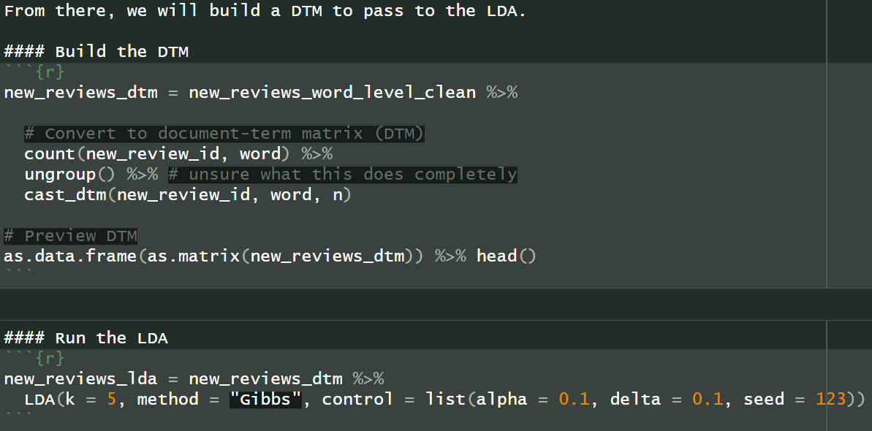
Topic Modeling
April 2024
Unstructured Data Analytics

Slide 21
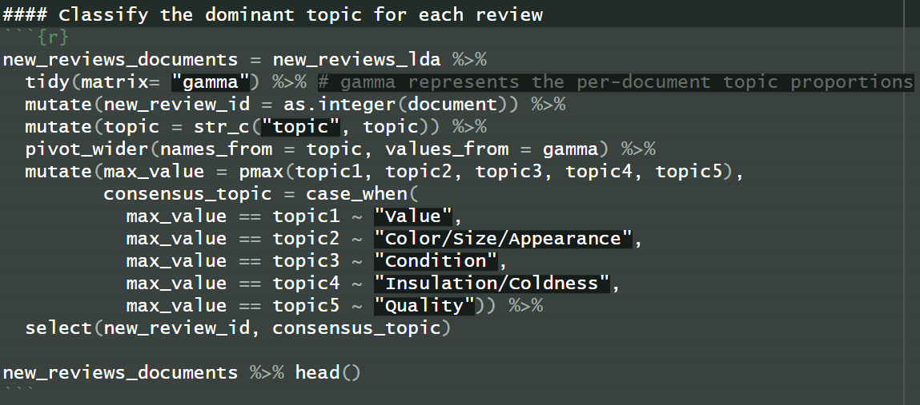
Topic Modeling
April 2024
Unstructured Data Analytics

Slide 22
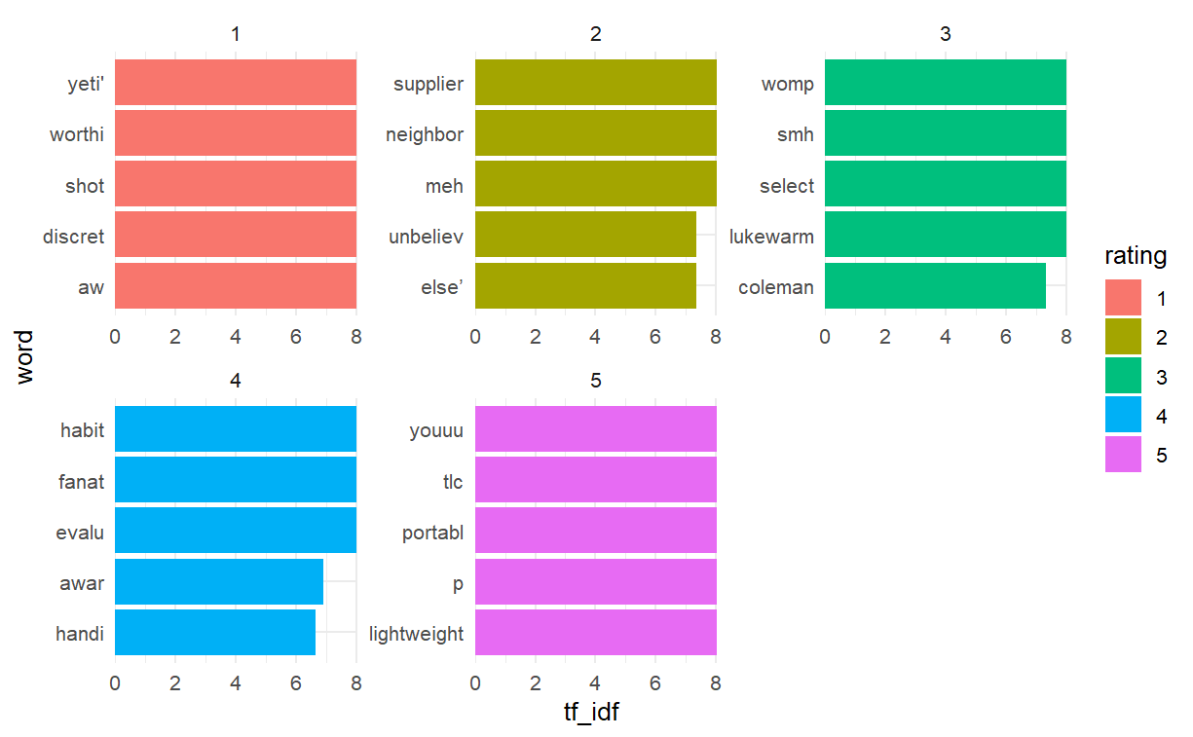
Top Words by Rating
April 2024
Unstructured Data Analytics

